Slide 1

Ethanol Content Measurement in Micro-brewed beer
Bsc. Gil Goldman
Unrestricted

Slide 2
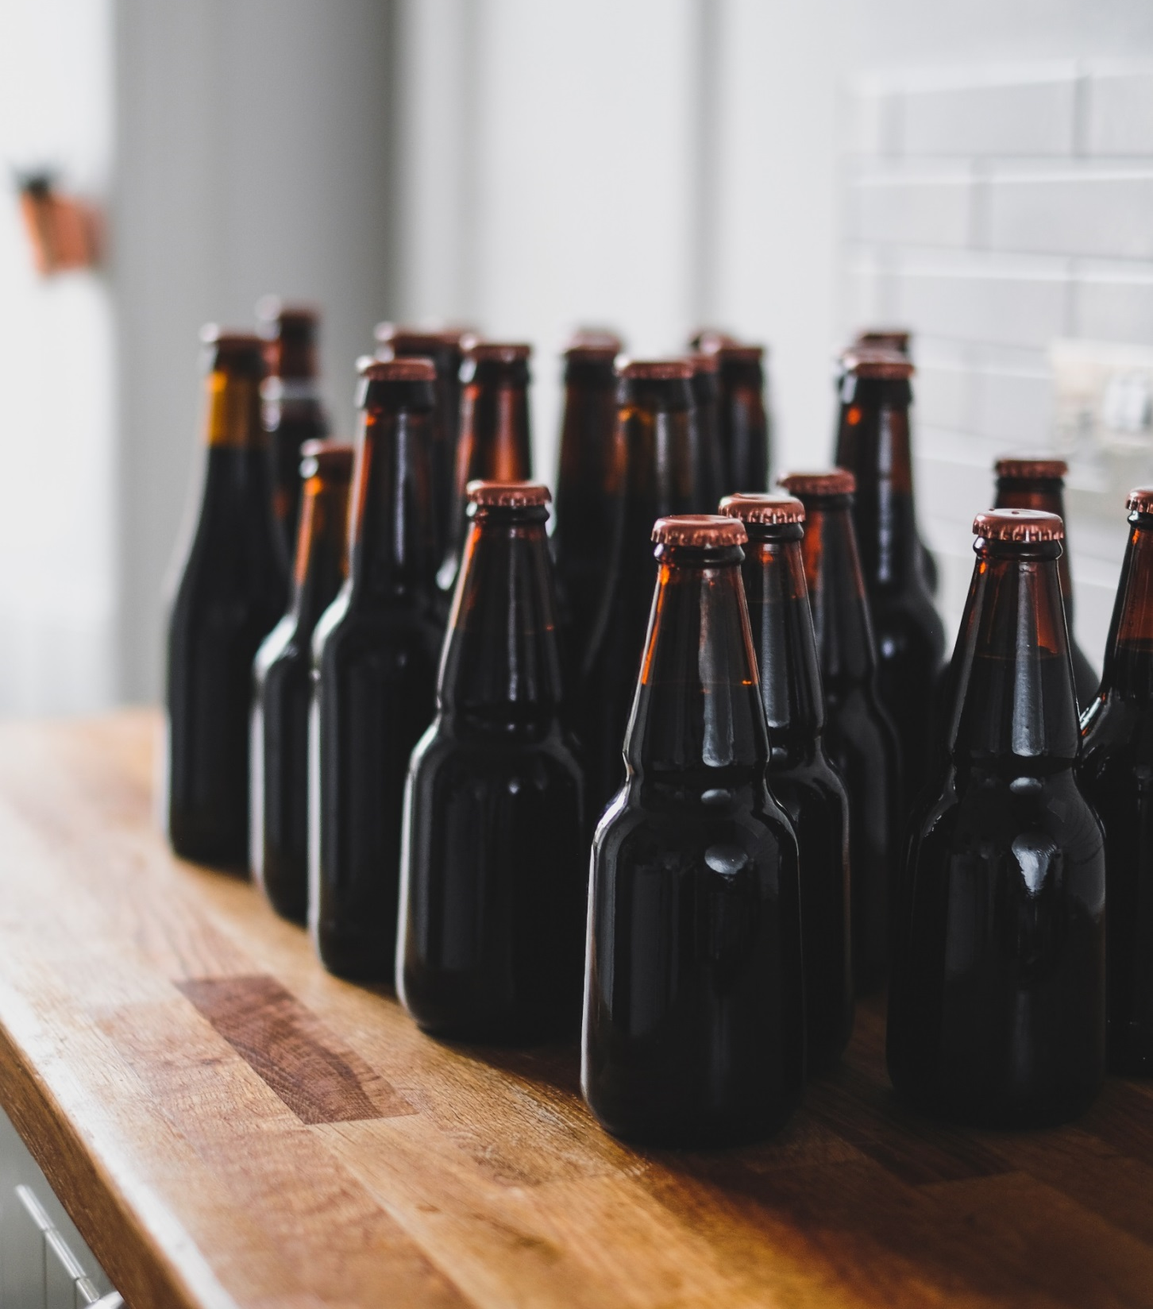
Thousands of liters of beer go wasted every day

Slide 3
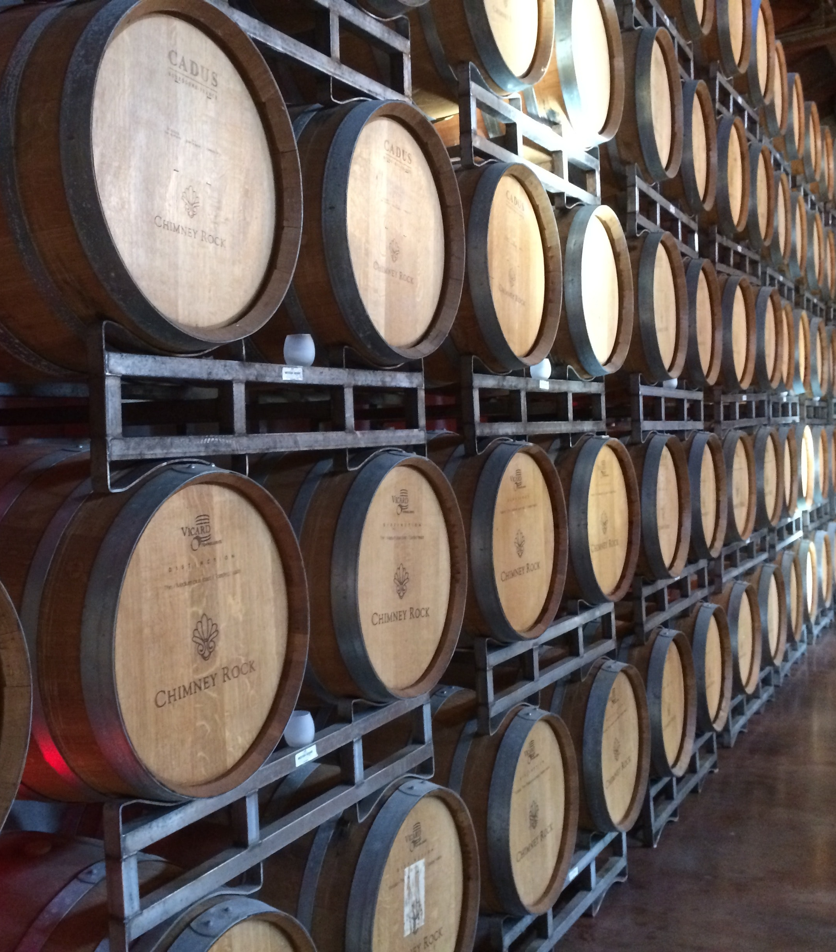
Gas Chromatography
NIRS and MIRS
Densitometry
Refractometry
Hydrometry

Slide 4
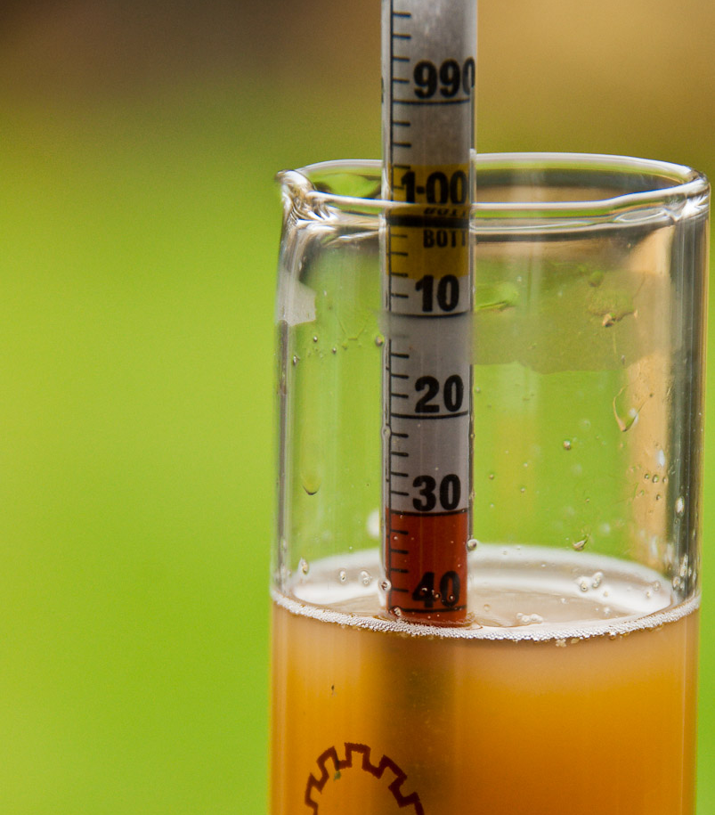
How it works
Retrieve a sample
Drop hydrometer
Check Hydrometer Depth
Compare result to tables and formulas
Throw away beer sample (!)

Slide 5
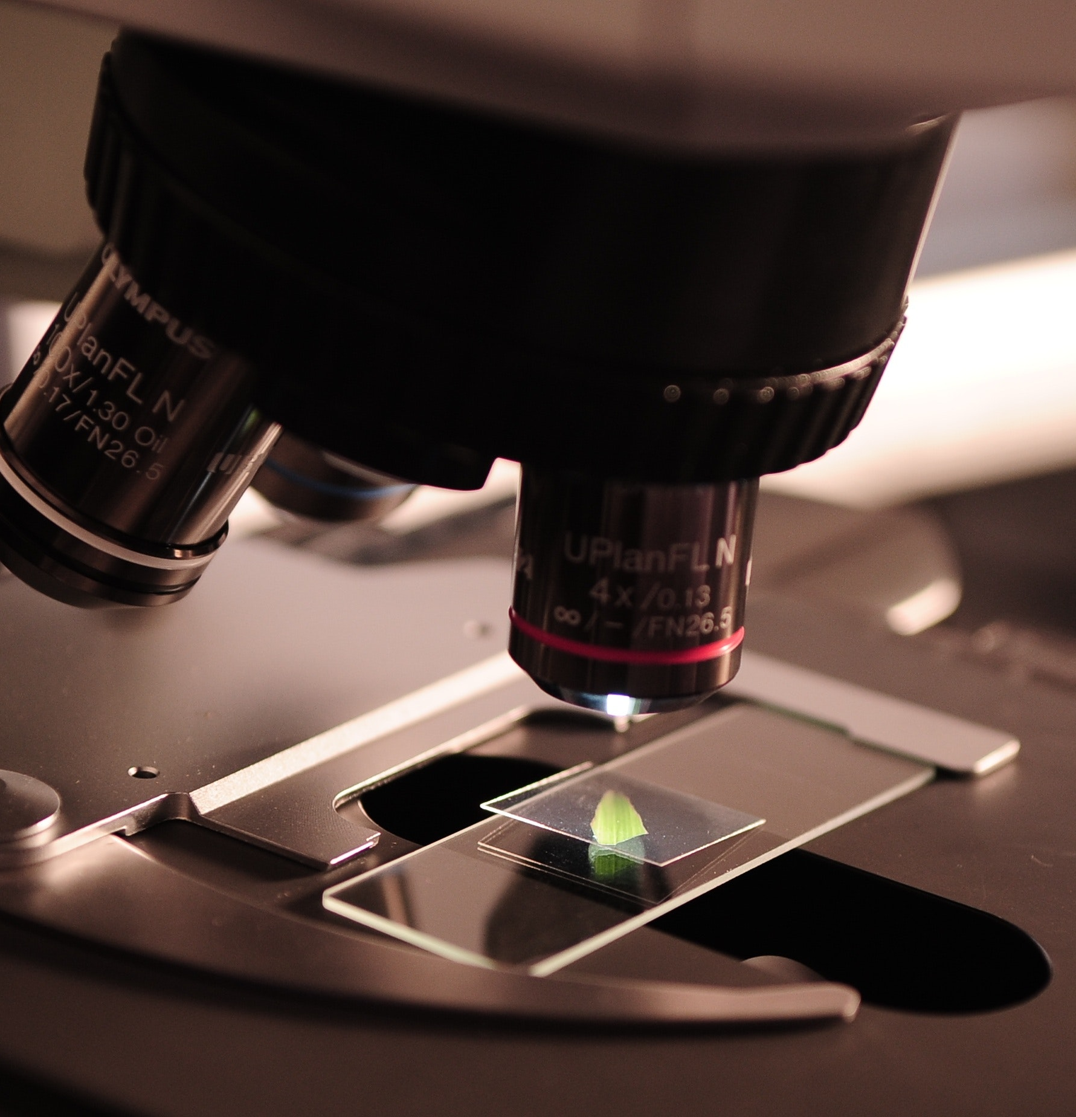
Hydrometers are everywhere
Easy to use
Simple to understand

Slide 6
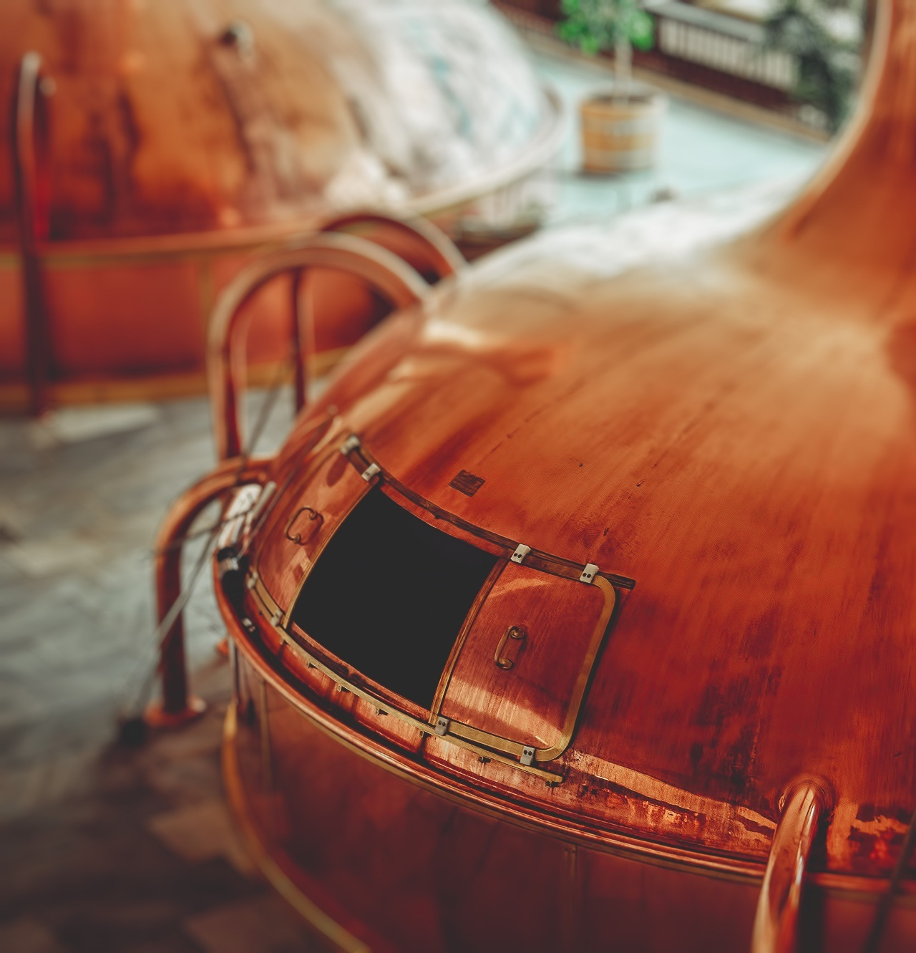
Parameters
Accurate
±2 mm
±0.002 SG
±0.26 ABV
Low Cost
Priority
Less than 15 $US

Slide 7
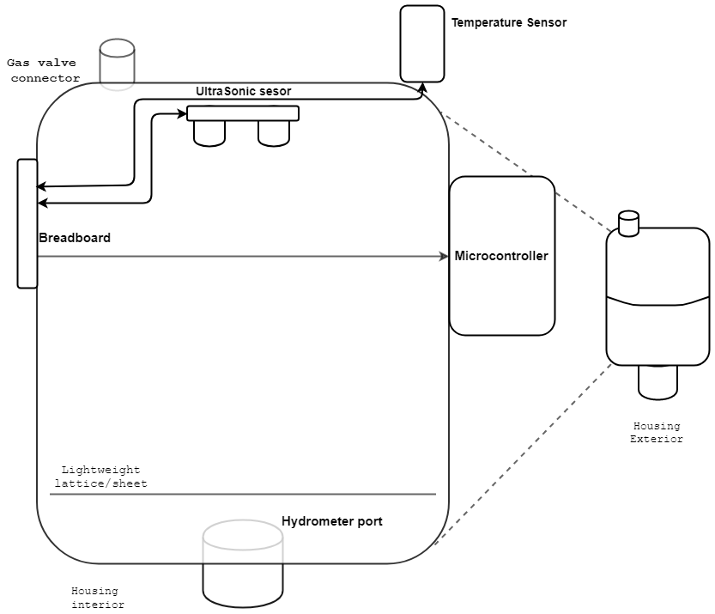
Physical Architecture
Raspberry Pi Zero W
HC-SR04
DHT11
Hydrometer + Lattice

Slide 8
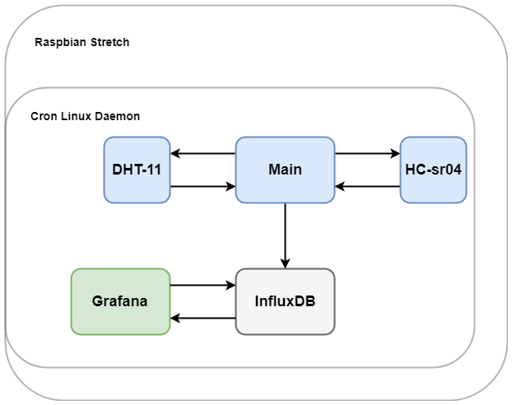
Software Architecture
Python, C
Over 1000 lines of code
Modular
Maintainable, usable, extendable

Slide 9
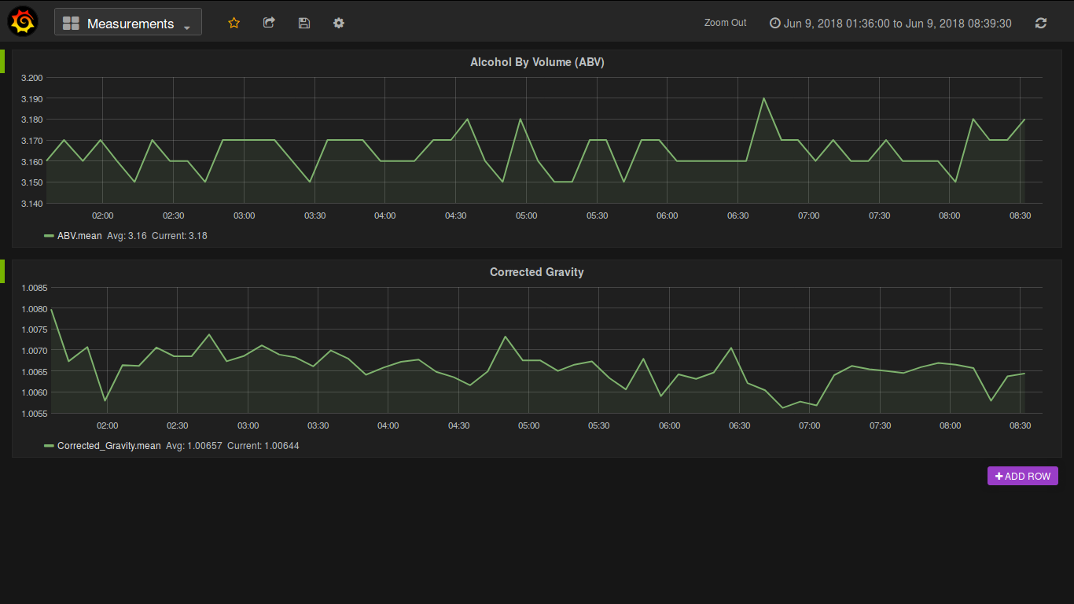

Slide 10
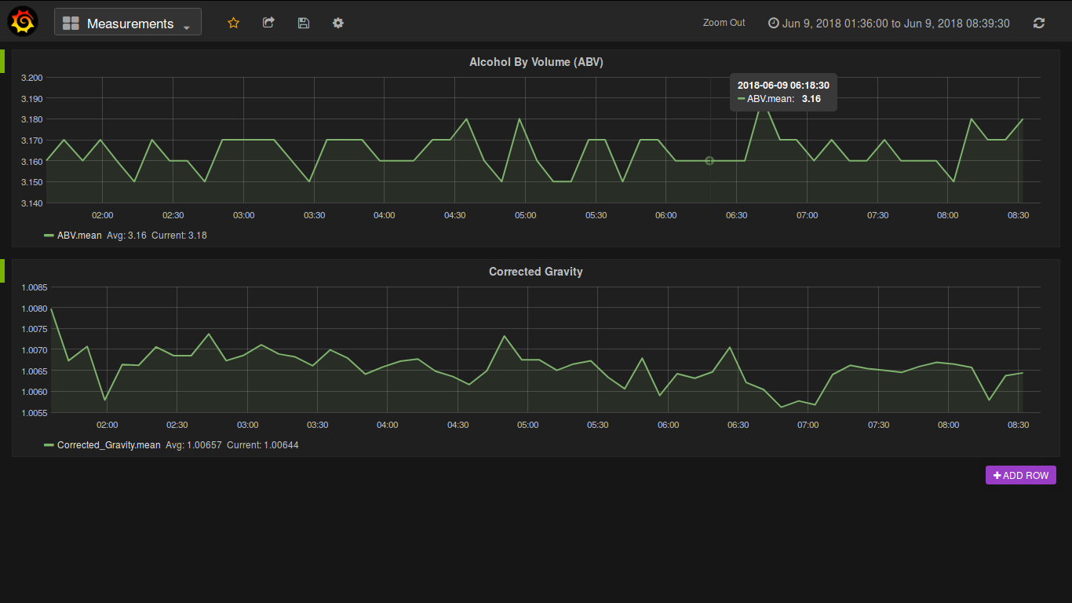

Slide 11
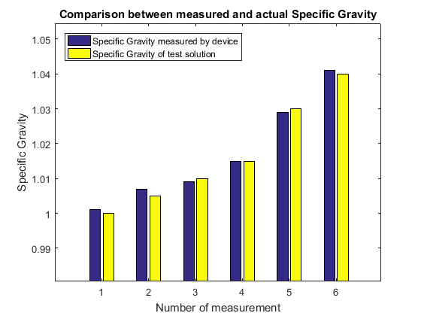
Conclusion
Final cost < 15$ USD
Distance accuracy < 1 mm
Corrected gravity accuracy < 0.002

Slide 12
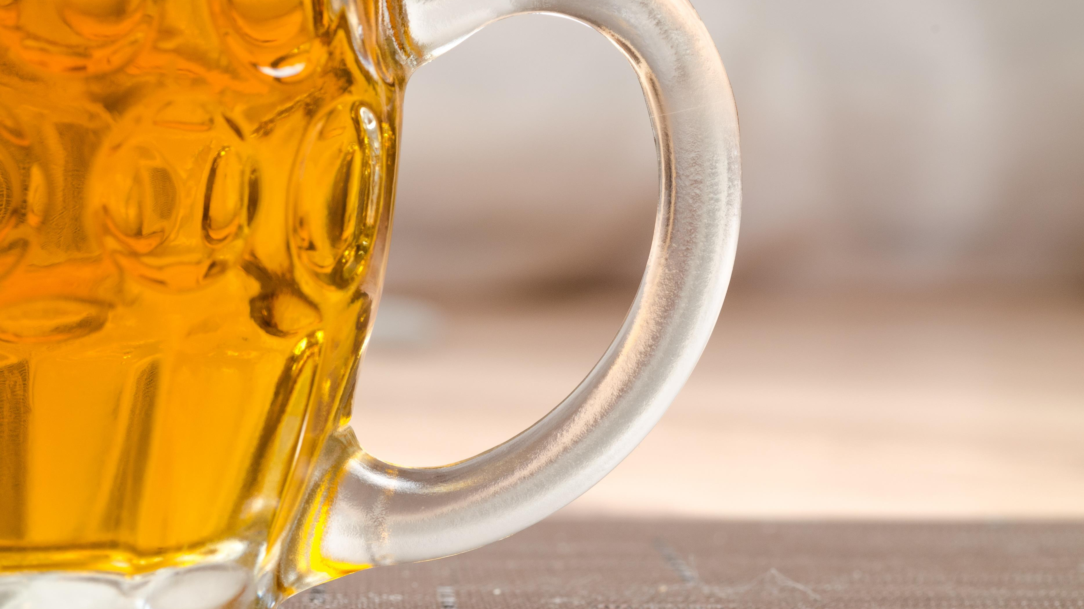
Happy to answer any questions
Title by Patrick Fore on Unsplash
Bottles by Adam Wilson on Unsplash
Brewery by Jeff Frank on Unsplash
Hydrometer by David Blaikie
Closing Beer by Lukas from Pexels

Slide 13
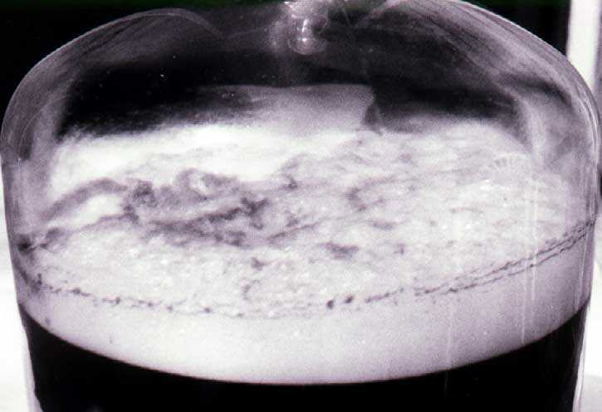
Krausen
Low density foam
Amount depends on beer being brewed
Wider point
Small actuator

Slide 14
Ultrasonic sensor dependence on temperature and humidity
Humidity - Negligible
“The variation of the specific heat ratio and the speed of sound in air with temperature, pressure, humidity, and CO_2 concentration”, O. Cramer, National Metrology Program, 1992
Temperature – negligible within working range
5-8 C difference due to fermentation
“Brewing Science and Practice”, D. E. Briggs ; C. A. Boulton ; P. A. Brooks ; R. Stevens, 2004
Pressure – Noticeable effect in high pressures
Device working assumption is that it will not be used in extremely high or low pressures
Mostly around 1 Atmosphere

Slide 15
HC-sr04 Drift
Negligible to non-existent
“Motion Measurement Using Inertial Sensors, Ultrasonic Sensors, and Magnetometers With Extended Kalman Filter for Data Fusion”, H. Zhao; Z. Wang, IEEE sensors Journal, 2012
Used to verify other sensors
DHT11 Temperature Drift
Negligible
Internal calibration routine
“Temperature and humidity module DHT11 Product Manual”, Aosong(Guangzhou) Electronics Co.,Ltd
DHT11 Humidity Drift
Noticeable – correction required
Drift irrelevant, humidity function not used

